Slide 1
Multi-agent Vehicle Data Analysis
Priya Krishnamoorthy
TECH103 Build and Deploy Your Own LLM-Powered Application

Slide 2
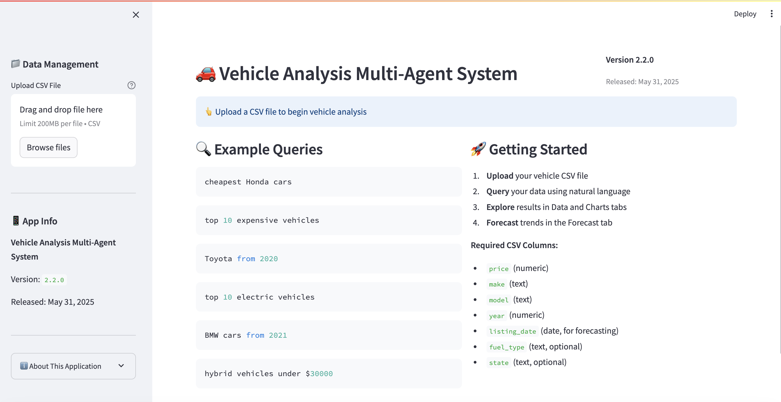

Slide 3
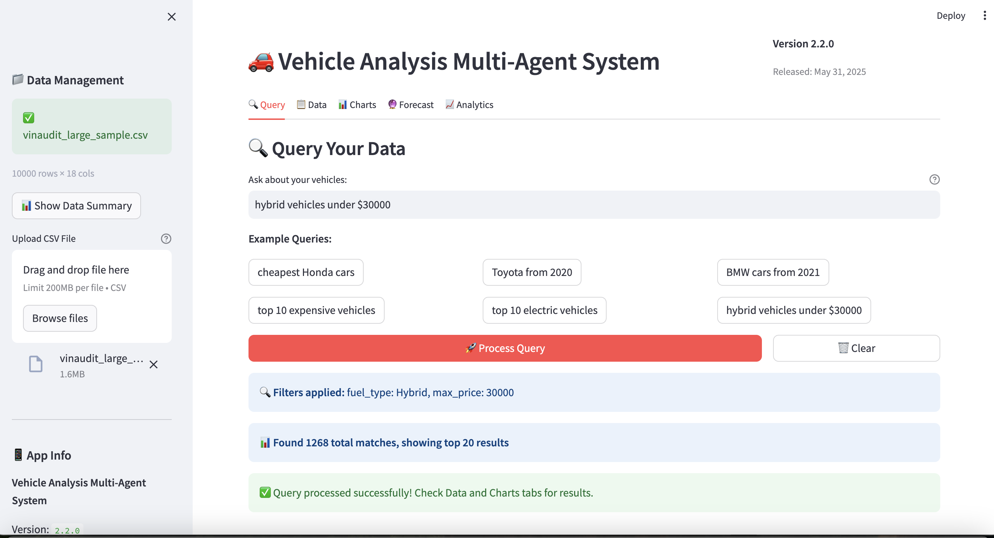

Slide 4
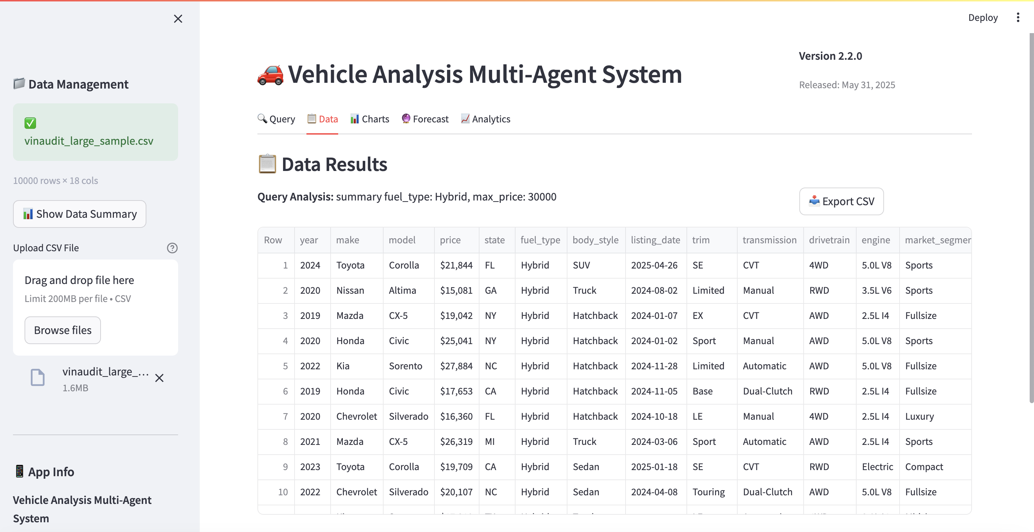

Slide 5
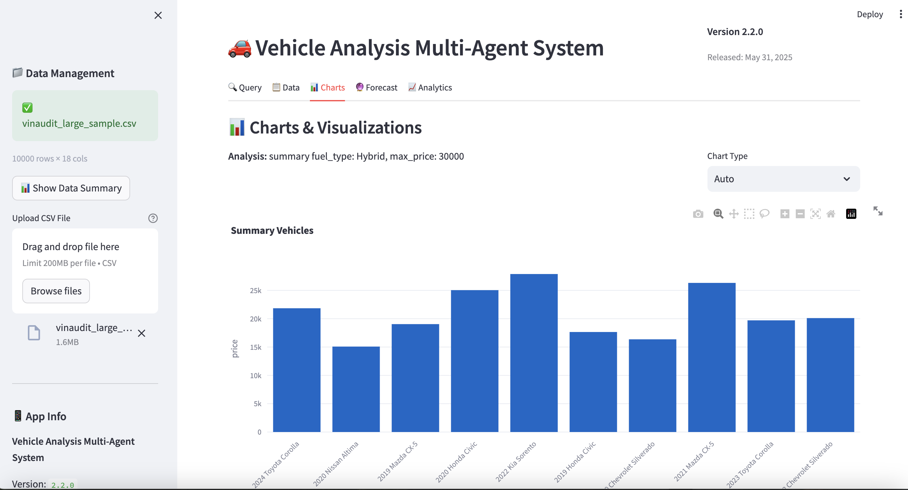

Slide 6
